Slide 1

Seasonal and diurnal trends in black carbon properties and
co-pollutants in Mexico City

Slide 2

Background
Black carbon has been identified as the atmospheric component whose regional warming effect on climate is second only to carbon dioxide.
BC is a contaminant whose negative effects locally can be significantly decreased through local and regional mitigation.
This is an optimistic possibility since BC is a product of inefficient combustion from motor vehicles, commercial processes, residential heating and cooking and open biomass burning.
Air quality stations in 1986 (Red Automática de Monitoreo Atmosférico – RAMA, http://www.aire.df.gob.mx/)
RAMA currently has 29 stations located in the MCMA (Fig. 1)

Slide 3
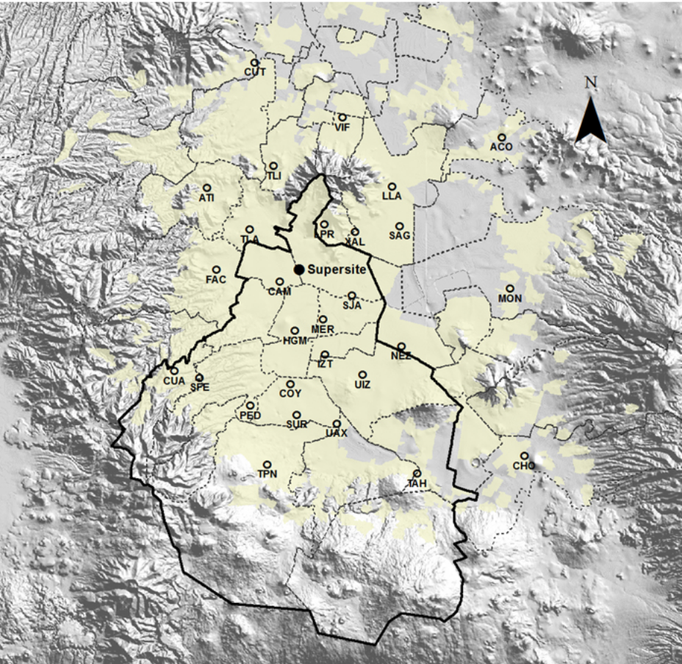
Figure 1. This map of the metropolitan area of Mexico City shows the locations of the RAMA air quality monitoring stations and the location
of the supersite where the measurements were made for this paper. Map courtesy of the Mexico City government (http://www.aire.df.gob.
mx/default.php).
www.themegallery.com

Slide 4
A mobile laboratory was deployed at various locations around the city. Filter samples were evaluated with electron microscopy and aerosol mass spectrometry and eBC was derived from an aethalometer.
In 2011, a new instrument, the Photoacoustic Extinctiometer (PAX) was installed at the RAMA supersite located in the north central section of the city (Fig. 1).
In March 2013, the PAX was certified by RAMA as an operational instrument for measuring the optical properties of BC relevant for climate.
The light-scattering and absorption coefficients, Bscat and Babs and the derived eBC. We report in this paper the results from a year of continuous observations made by this instrument since March 2013.

Slide 5
Measurement methodology
The RAMA “supersite” (Fig. 1) is located in an area of the city that is a mixture of private residences and industry.
Although the majority of the BC comes from the trucks, by the time the air reaches the measurement site, the BC is well-mixed with the CO, NO and other particles that are produced by the cars and buses as well as by the trucks.

Slide 6
Meteorology, radiation, gas and PM2:5 measurements
Temperature and relative humidity are measured using a Met One (Met One Instrument, Grants Pass, OR) model 083E sensor located inside an aspirated radiation shield. Wind speed and direction are measured with a Met One model 010C lightweight three-cup anemometer, and a Met One model 020C lightweight airfoil vane.
The temperature and relative humidity sensors are positioned in a meteorological tower 4m above the ground.
The anemometer and vane are located at the top of the 10m meteorological tower.
Ozone is measured by ultraviolet photometry. PM2:5 is measured with a TEOM 1400A ambient particulate monitor 8500C FDMS

Slide 7
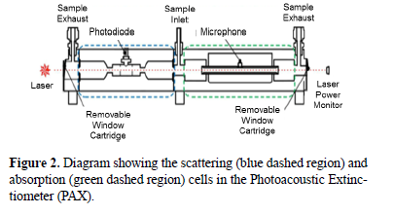
The Photoacoustic Extinctiometer
The eBC, Bscat and Babs are derived from the PAX. A sensor that evolved from the Photoacoustic Soot Spectrometer (PASS), and commercialized by Droplet Measurement Technologies.
The PAX performs simultaneous measurements of aerosol scattering and absorption coefficients using a single diode laser modulated at approximately 1500 Hz. The 375, 405, 532 and 870 nm single wavelength versions of the instrument have identical measurement cells and differ only in a few optical components.
The PAX whose measurements are reported in the current study uses the 870 nm laser.

Slide 8
The Photoacoustic Extinctiometer
The sample flow passes into an acoustically insulated enclosure containing the sample cells, where it is then split, making opposing 90 degree turns into the scattering and absorption measurement regions.
The sample is exhausted through two ports at the ends of the absorption cells before being filtered and pumped out of the instrument.
The flows are controlled using critical orifices and do not affect the calculated absorption and scattering coefficients, which depend only on the properties of the sampled particles and geometry of the measurement region.
The microphone signal is passed through a fast Fourier transform circuit that gives the peak power at the resonator frequency, which is calculated based on the resonator geometry, air pressure, temperature and dew point temperature measured in the cell. The microphone raw pressure signal (pmic) is converted to the raw light absorption coefficient using the equation.

Slide 9

The Photoacoustic Extinctiometer
where A is the resonator cross section, f is the calculated resonator frequency, PL is the laser power, is the ratio of isobaric and isochoric specific heat for air, Q is the calculated resonator quality factor (also calculated from measured cell pressure, temperature and dew point temperature) and _x001e_rPhi raw is the phase raw absorption signal relative to the phase of the laser power signal plus the phase correction.
The raw absorption and scattering signals must be corrected for background absorption and scattering signal in the cell to give the desired light absorption and scattering coefficients due to the sampled aerosol particles.

Slide 10
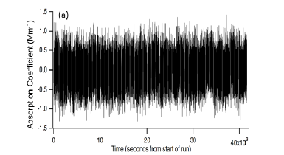
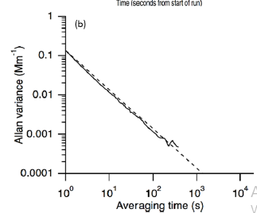

The Photoacoustic Extinctiometer
Figure 3 shows the corrected absorption coefficients and Allan variance plot for the absorption signal measured during overnight sampling of filtered air with an 870 nm PAX. The instrument performed a background measurement approximately every 10 min, which corrected for the instrument drift on timescales longer than 10 min, so the variance is only shown up to a 5 min averaging interval.

Slide 11

The Photoacoustic Extinctiometer
The PAX is calibrated through a two-step process by first introducing high concentrations of purely light-scattering particles followed by high concentrations of partially absorbing particles to the measurement cells.
The concentrations must be high enough to allow direct measurement of the extinction coefficient (bext) from the reduction in laser power measured at the laser power monitor (Fig. 2) using Beer’s law:
Where I is the average laser power measured when the high concentration of particles is being sampled, I0 is the average laser power immediately before and after the high concentrations are introduced to the cell and l is the path length of the laser beam through the entire optical cavity (scattering region and absorption region) between the two windows, which for the PAX is 0.354 m.

Slide 12
The Photoacoustic Extinctiometer
The relationship between the measured extinction and scattering coefficients are fit using a linear regression giving a calibration factor for the scattering measurement.
Introducing calibration particles that have non-zero absorption means the measured extinction equals the now-calibrated scattering coefficient plus the absorption coefficient.

Slide 13
Correlations and causal links between co-pollutants
Figures 11–13 are correlations between pairs of pollutants, as a function of the lag time that is varied from -10 to +10 h, in 10 min increments.
The vertical black dashed line is drawn at the zero lag time and the horizontal black dashed line is drawn at the crossover point from positive to negative correlation.
The colors of the lines denote the season using the same coding as previous figures.
Figure 11a illustrates the relationship between CO and NOx and indicates that these two pollutants are highly correlated (R D 0:9) with no lag time,

Slide 14
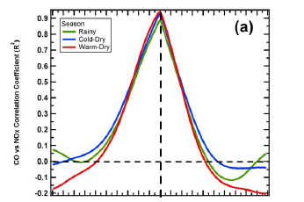
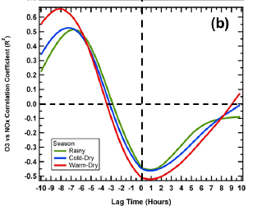
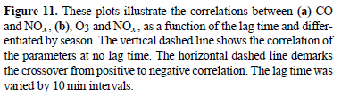
www.themegallery.com

